Slide 1
Analyzing MLB Hitters Using Statcast Data
Group 6: Robert Lawrence, Noah Stevenson, Cole Sherwin, Tomas Banuelos

Slide 2
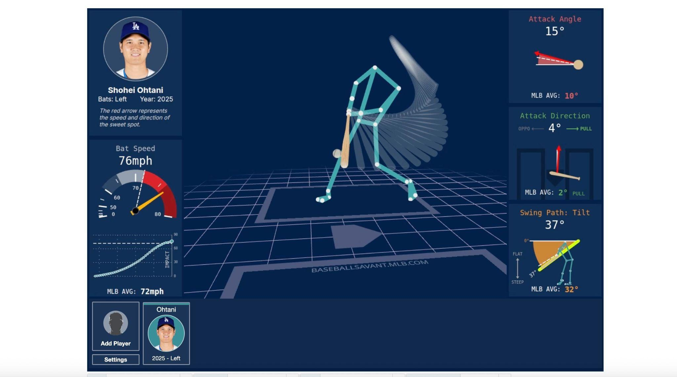
Inspiration
An example dashboard of the new bat path metrics (Source: Baseball Savant)
Notes:
In May 2025 Major League Baseball (MLB) publicly released new swing path metrics for hitters compiled from the 2023 season to now. We wanted to know if these new metrics could help us get a better understanding of how to evaluate a hitter.

Slide 3
What Makes a Hitter “Good”?
Getting on Base
Scoring Runs
Driving in Runs
The Measures
On Base Plus Slugging Percentage (OPS)
Weighted On Base Percentage (wOBA)
Notes:
The measure of a good hitter is really done in two ways now a days. You have your traditional production states that are both rates and counting stats meant to assign value to an individual players contributions and outcomes and all encompassing stats meant to give a measure of a hitters total offensive contributions.
Production Stats: Batting Avg (BA), On-Base Percentage (OBP), Slugging Percentage (SLG), HRs, RBIs, Runs,
All Encompassing Sats: Weighted On Base Percentage (wOBA), On Base Plus Slugging (OPS), Wins Above Replacement (WAR)

Slide 4
Initial Assumptions to Explore
Bat Speed vs. Contact Percentage
Assumption: Faster bat speed may reduce contact percentage due to more aggressive swings and narrower timing windows.
Bat Speed vs. Swing Length
Assumption: Longer swings could result in higher bat speed.
Swing Length vs.Opposite Field Percentage
Assumption: Shorter swings allow better plate coverage and timing, potentially increasing opposite field hitting.
Swing Length vs. Pull Percentage
Assumption: Longer swings correlate with higher pull percentages, especially for power hitters trying to lift balls to their pull side.

Slide 5
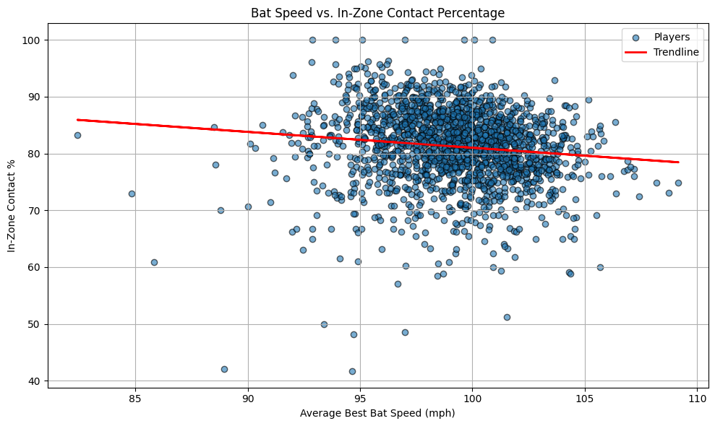
Bat Speed vs. Contact Percentage
Assumption: Faster bat speed may reduce contact percentage due to more aggressive swings and narrower timing windows.
Notes:
This chart shows that as bat speed increases, in-zone contact rate tends to decrease slightly — suggesting that power swings may come at the cost of contact consistency.
Not all elite bat speed hitters are high-contact players — and vice versa.

Slide 6
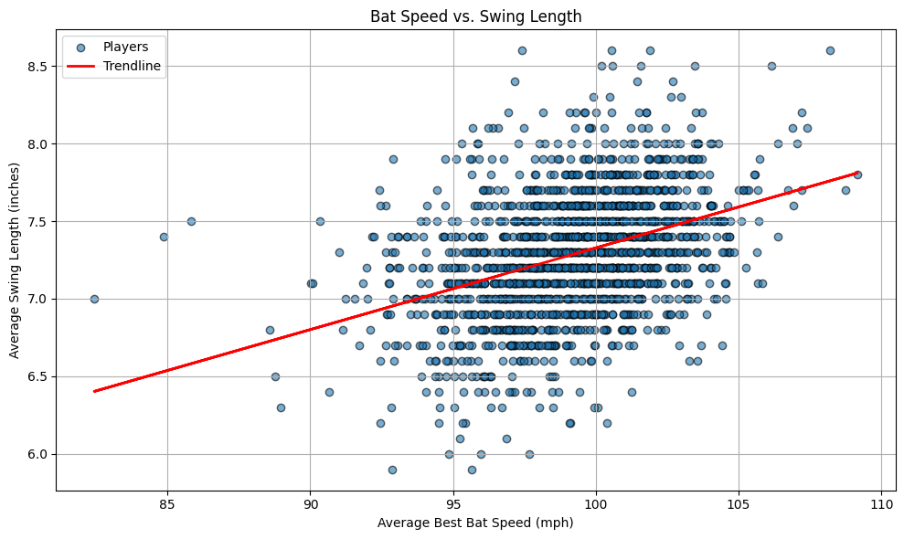
Bat Speed vs. Swing Length
Assumption: Longer swings could result in higher bat speed.
Notes:
This chart shows a moderate positive trend between swing length and bat speed — suggesting that some hitters generate bat speed through longer, more rotational swings.

Slide 7
Swing Length vs. Opposing Field Percentage
Assumption: Shorter swings allow better plate coverage and timing, potentially increasing opposite field hitting.
Notes:
This chart shows that shorter swings are generally associated with a higher percentage of opposite-field contact.
Compact swings give hitters more time and control — ideal for going the other way.

Slide 8
Swing Length vs. Pull Percentage
Assumption: Shorter swings allow better plate coverage and timing, potentially increasing opposite field hitting.
Notes:
This chart shows a clear positive relationship between swing length and pull percentage — hitters with longer swings are more likely to turn on the ball and pull it.

Slide 9
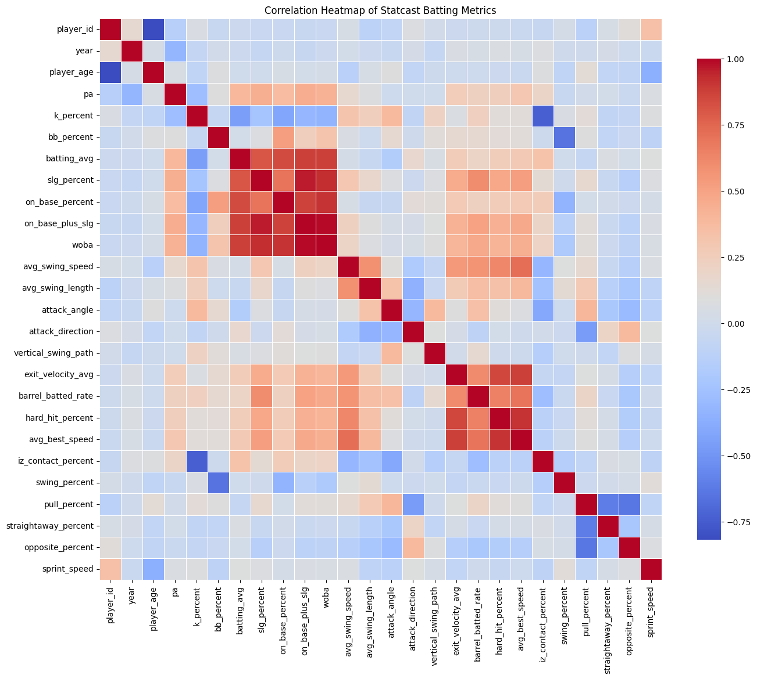
Correlation Heatmap
Hot Spots
batting_avg
slg_percent
on_base_percent
on_base_plus_slg
woba
exit_velocity_avg
barrel_batted_rate
hard_hit_percentage
avg_best_speed
Notes:
We see a couple of definite hot spots so let’s take a closer look.
Batting_avg (batting average)
Slg_percent (total divided by at bats)
On_base_percent (hits + walks + HBP) divided by plate appearances
on_base_plus_slg
Woba (weighted version of on-base %)
The first group all measure similar data (hits, walks, total bases) and some are composite formulas of others (like OPS = OBP + SLG). They all measure offensive output using similar ingredients.
Exit_velocity_avg (Average speed (in mph) off the bat for all batted balls)
Barrel_batted_rate (% of batted balls with ideal EV & launch angle)
Hard_hit_percentage (% of balls hit ≥ 95 mph)
Avg_best_speed (Average speed of the ball off the bat)
The second group are all looking at how hard the ball is hit.

Slide 10
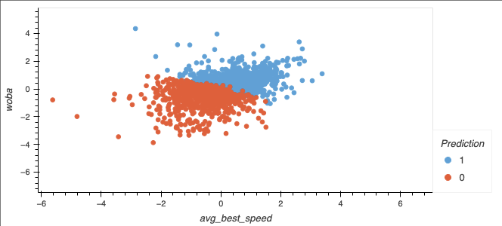
Unsupervised Learning
Lots of bad little good
X = Ball speed coming off the bat
Y = All the ways you can get on base
Notes:
Gave sklearn access to the whole DB do see if it could draw any conclusions on its own, this ended up not being our best model option so we moved to supervised learning.
'player_id','year', 'player_age', 'pa', 'k_percent', 'bb_percent',
'batting_avg', 'slg_percent', 'on_base_percent', 'on_base_plus_slg',
'woba', 'exit_velocity_avg', 'barrel_batted_rate', 'hard_hit_percent',
'avg_best_speed', 'iz_contact_percent', 'swing_percent', 'pull_percent',
'straightaway_percent', 'opposite_percent', 'sprint_speed'
sklearn.cluster import KMeans
from sklearn.decomposition import PCA
from sklearn.preprocessing import StandardScaler

Slide 11
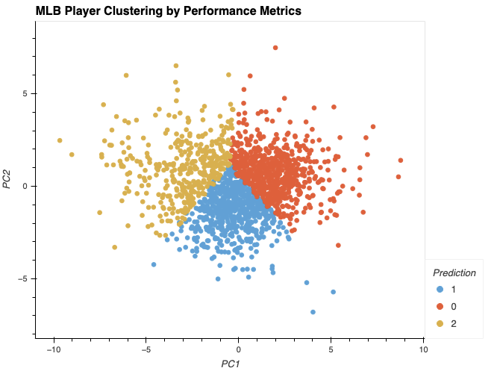
Unsupervised Learning
Very close to each other in terms of these metrics
Cluster 0 might be balanced hitters.
Cluster 1 might be power sluggers with high strikeouts.
Cluster 2 might be contact-speed players with high average and speed.
Notes:
The avg from each cluster is very close to the others

Slide 12
Can We Predict OPS?
Obstacles in the Data
How to Weight (2023/2024) versus 2025
Outliers
Reducing Dimensionality
Notes:
The key points were
Wanted to get rid incomplete data (under 450 PA in 2023/2024 and 150 in 2025)
Removed Outliers (OPS under 600)
Created new columns (iso and k-bb)

Slide 13
The Features
Do you hit the ball hard?
Do you make contact?
What are your physical measures?
Notes:
Hit the ball hard:
Barrel percentage
50th percentile Avg Exit Velocities
Isolated power
Making Contact:
In zone contact percentage
Swing percentage
k-bb
Physical Measures:
Swing Speed
Swing length
Attack angle (how on plane you are at contact)
Attack direction (how on time you are)
Vertical swing path (the tilt of your swing)
Sprint Speed

Slide 14
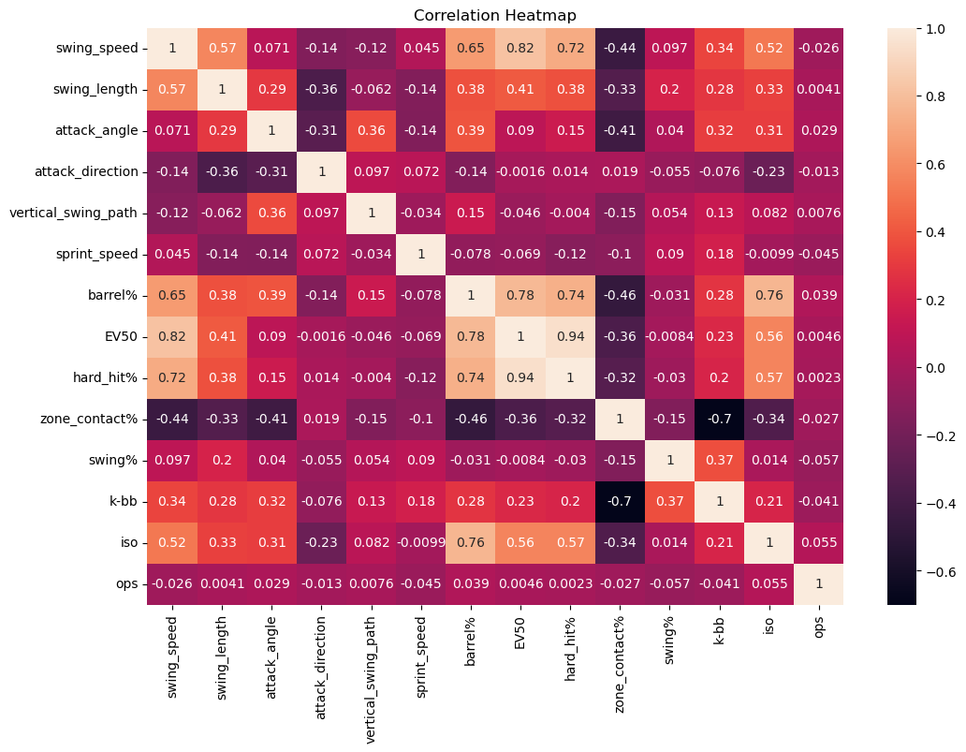
Looking for Correlations
Notes:
Some things match our intuition, like swing length and swing speed are strongly correlated, or hard hit percent and EV50 being almost 1-1.
Another thing that matches our intuition is that nothing is strongly correlated with ops. (if there was an easy answer then every team would be doing it)
Unfortunately from this heatmap it doesn’t appear that there are any obvious correlations for the new swing path metrics

Slide 15
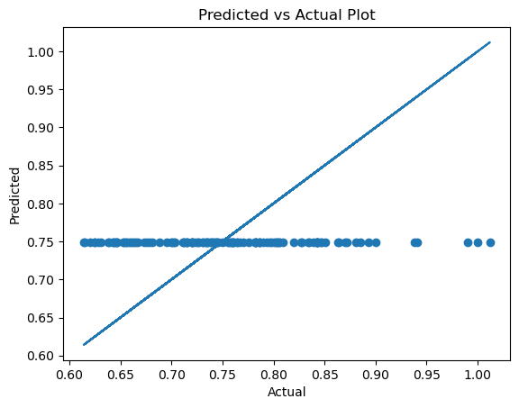
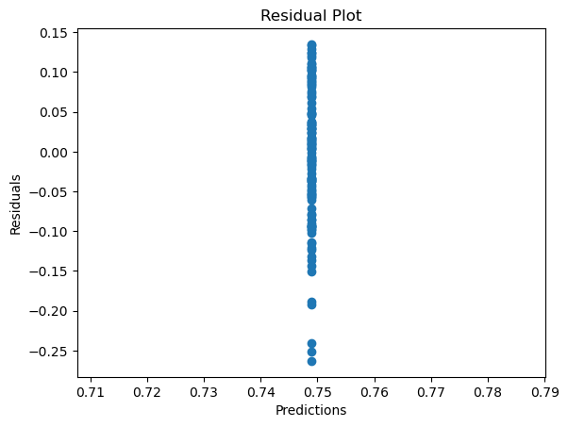
Our Models (The Bad)
Elastic Net
Notes:
Elastic Net flattened all the data. Overall very bad model

Slide 16
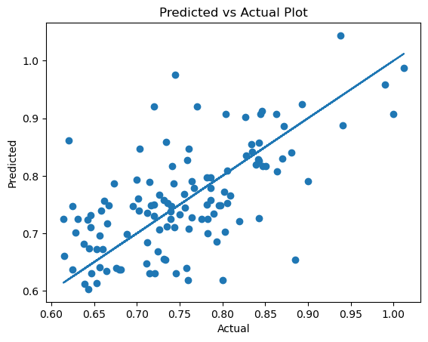
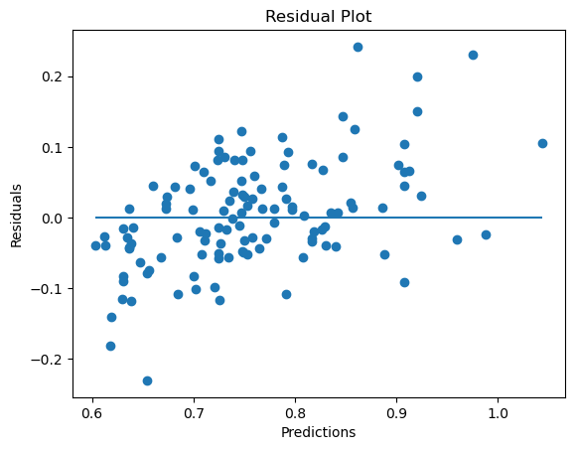
Our Models (The Bad)
Decision Tree Regressor
Notes:
It doesn’t look so bad, but it actually overtrained to a criminal degree (perfect with the training data). While we can see from the residual plot it had some very bad test metrics

Slide 17
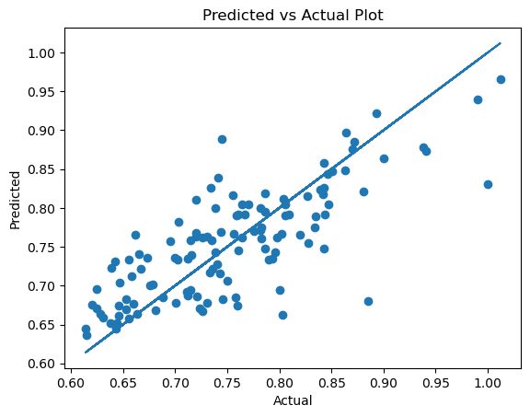
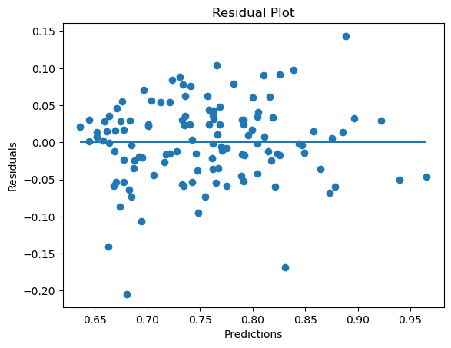
The Winner
Gradient Boosted Regression
Notes:
Overfitting but on the lower end, but rmse is low (54 points of OPS) and predictions are more consistent within the .700 OPS range

Slide 18
Deep Dive Into Top Correlated Metrics
Notes:
So after all that we have analyzed How can we find a good hitter? Well the problem is there is just too many variables to determine what makes a good hitter. When we first started this project we wanted to create a model that would indicate what 9 players to draft. using Top Correlated metrics from the supervised learning model and Tableau we created the dream team. The metrics used to find players are ISO (akaSlg) and Barrel%, Hard_hit% and Barrel%, Hard_hit% and Swing Speed, Barrel% and Swing speed, Hard_hit% and ISO, And lastly Swing length and Swing speed. Note: I left out correlations with EV50 because i wanted to give each player a fair chance and base the team off of everyone's averages.

Slide 19
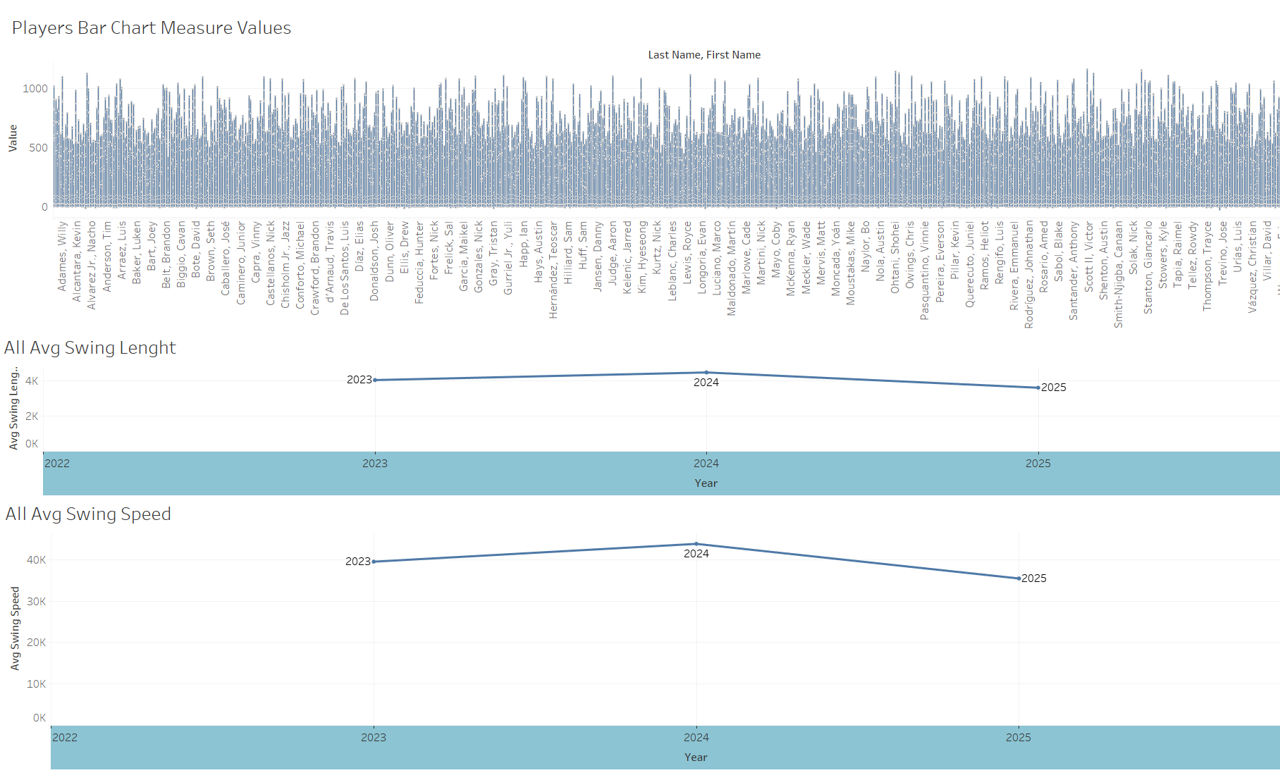
The Dugout
Notes:
Thinking on how easy it would be to take all the top correlated metrics throw them into a quick sheet and sort all players by top 9 and done! Which is what I did but after digging a bit deeper it's not that simple.

Slide 20
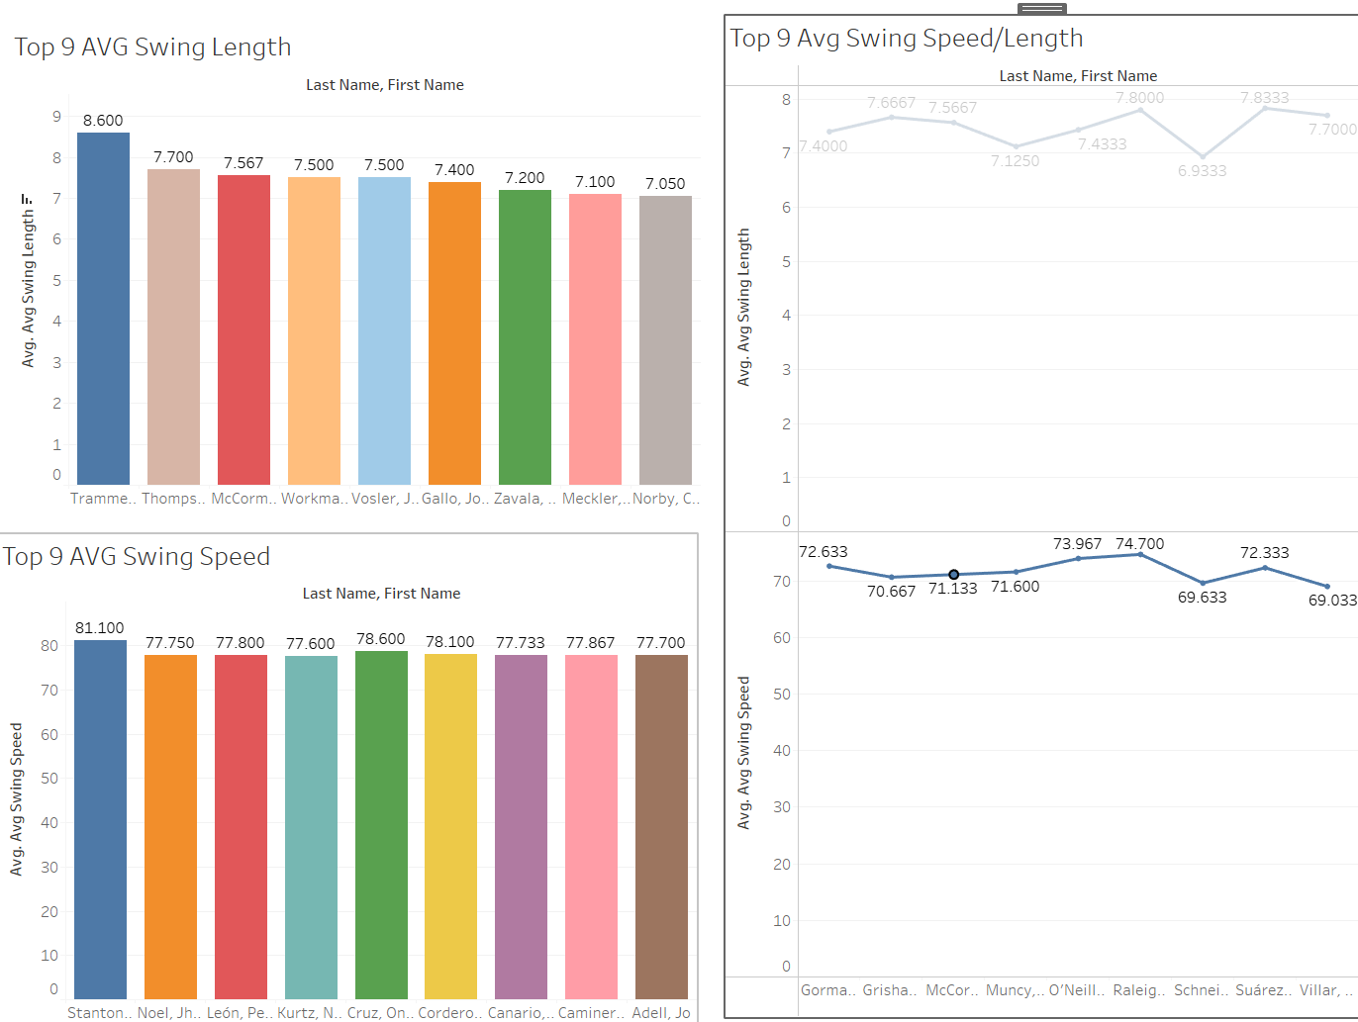
Chas McCormick
Notes:
Chas McCormick, Number 20 currently plays outfielder for the Houston Astros is in the top 9 for avg swing length and when comparing avg swing speed and swing length he made the list. On top of that he also makes part of the top 9 Hard hit% and Barrel%.

Slide 21
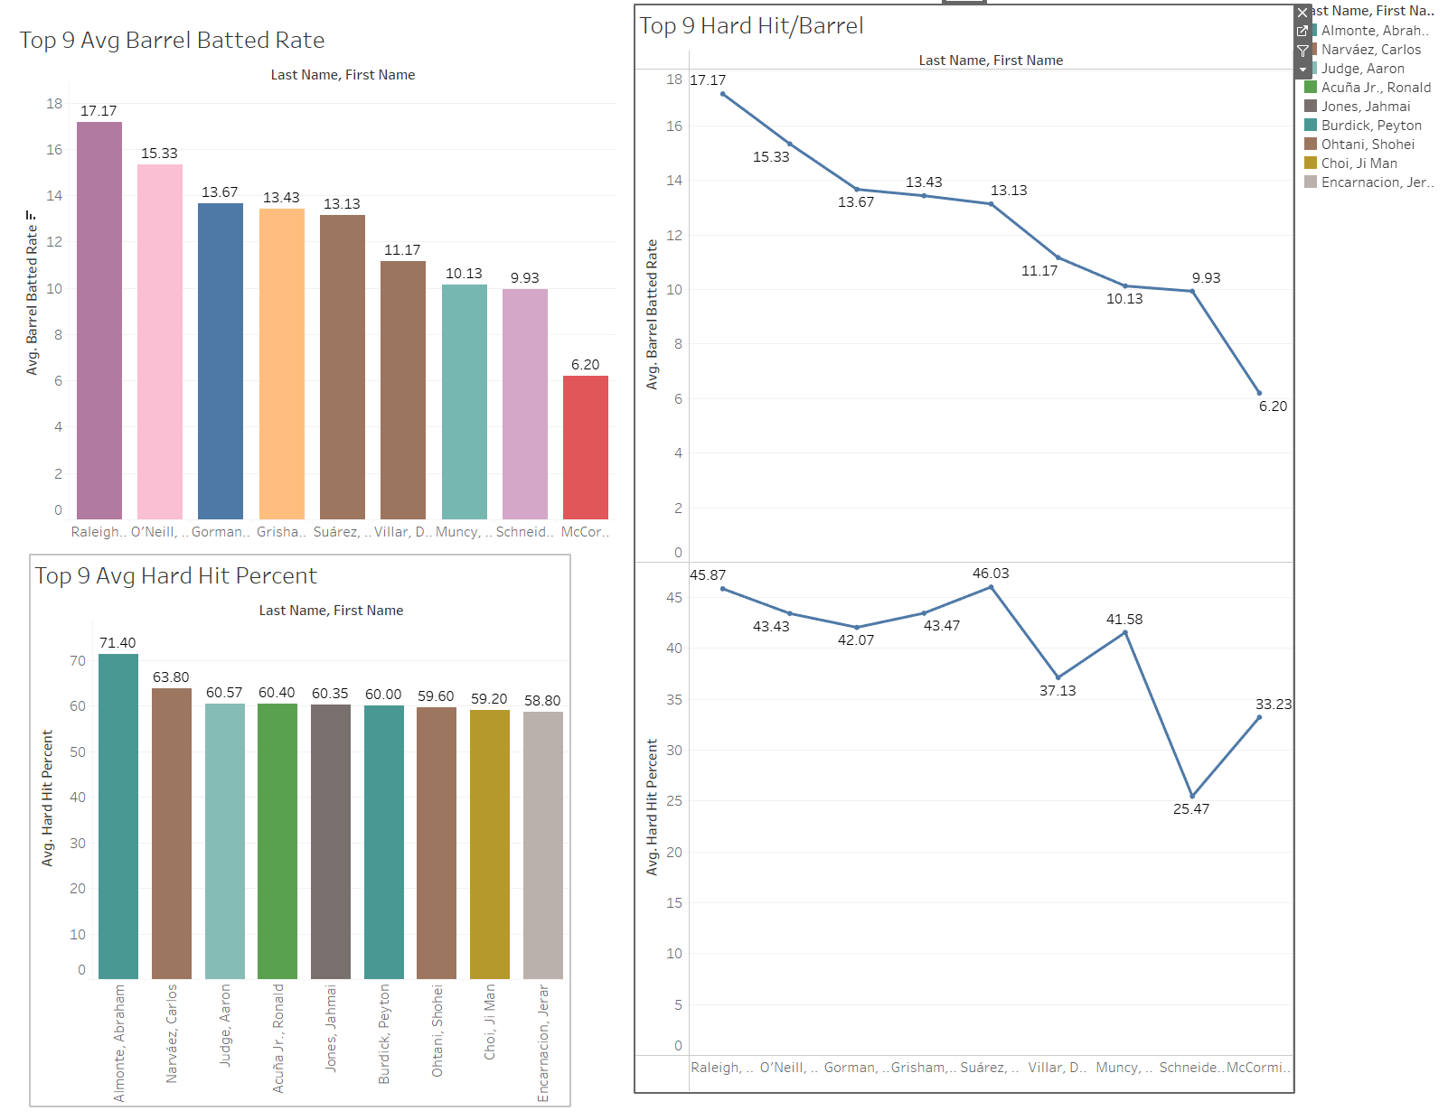
Barrel Percent
Notes:
Next metric correlation i looked into was barrel % and Hard Hit %. The interesting thing to notice here is all players in the top 9 barrel % also made the top 9 barrel percent and hard Hit list.

Slide 22
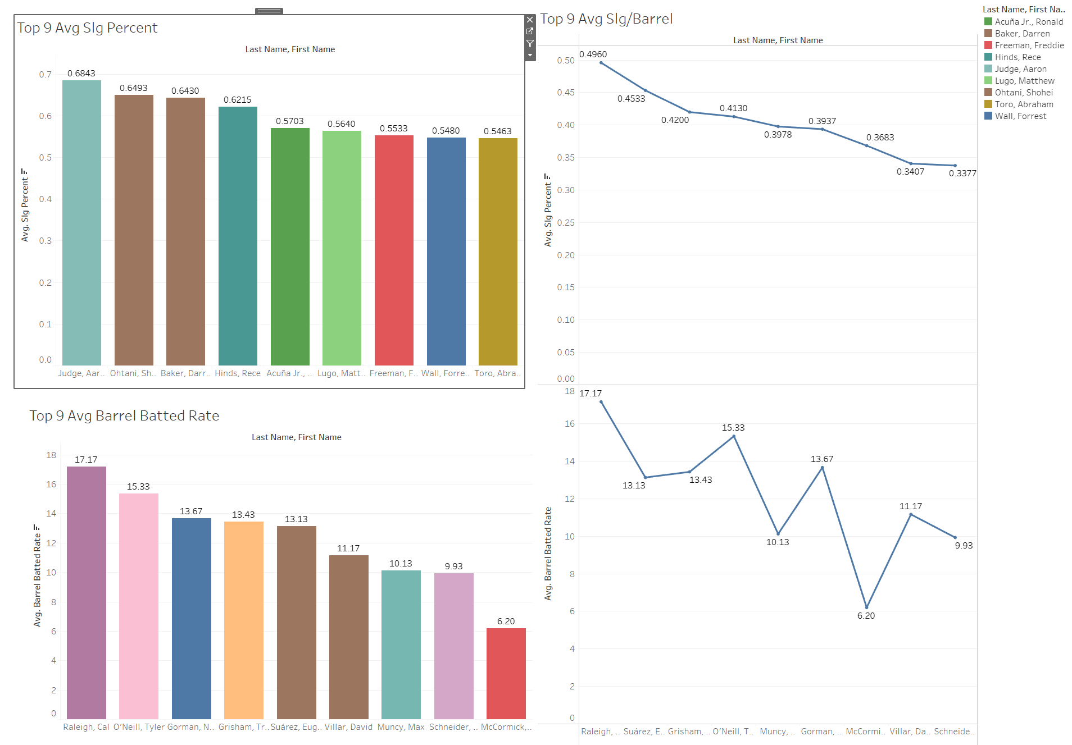
Barrel Percent
Notes:
Comparing barrel and iso all players in the top 9 barrel percent made the comparative list. Further showcasing that players with high barrel % averages might be on their way to the top.

Slide 23
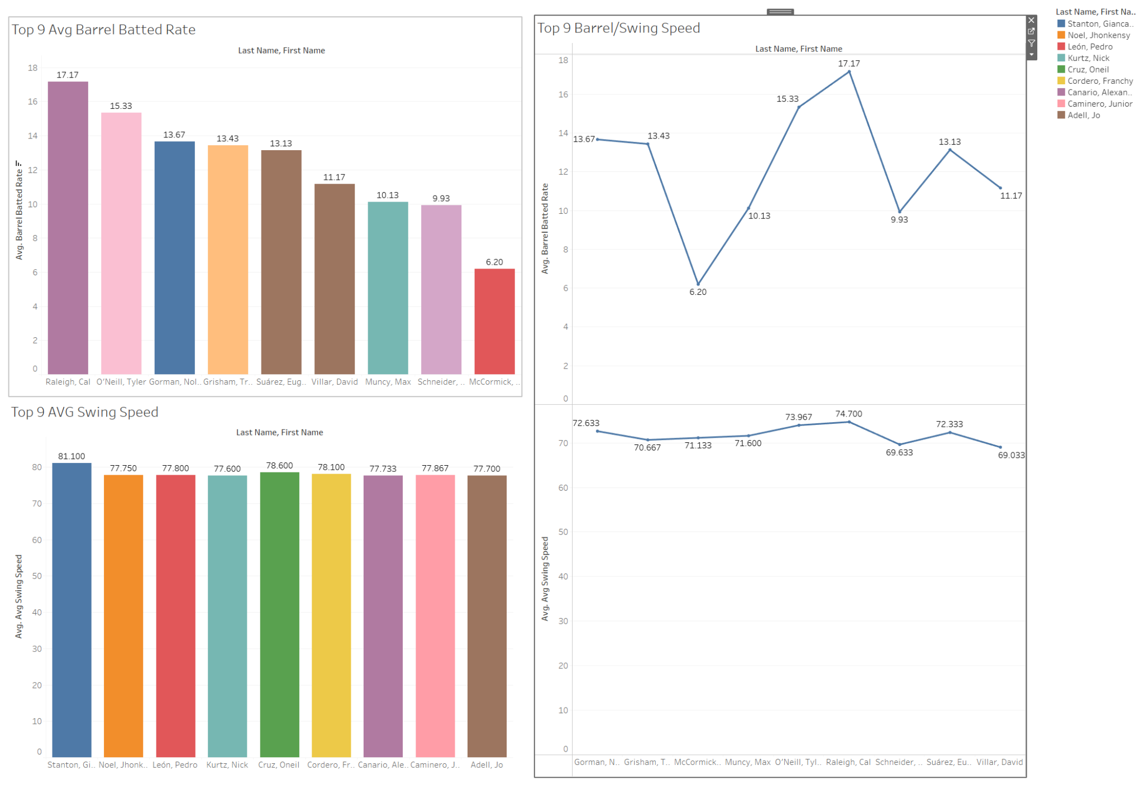
Barrel
Notes:
Again all Top 9 barrel % average players made the correlation list

Slide 24
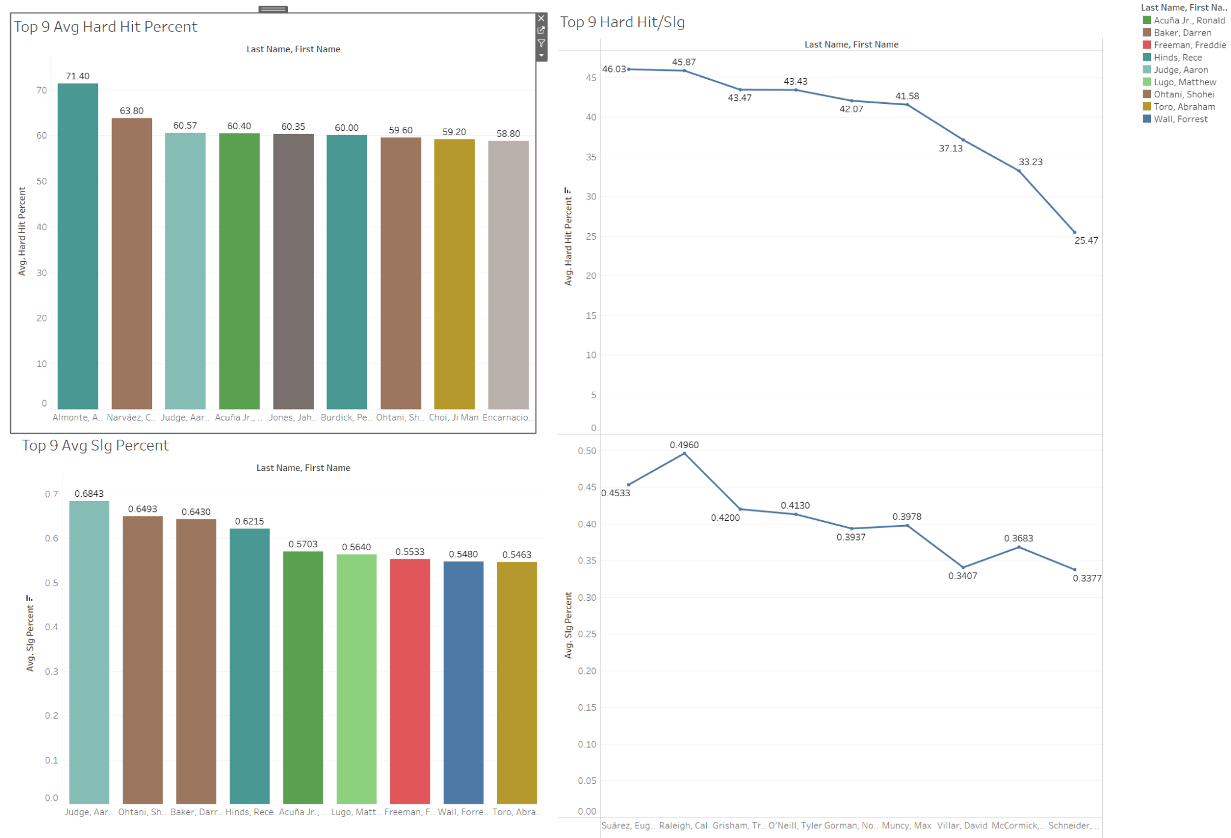
Hard Hit & ISO
Notes:
The last correlation I looked at was Hard Hit % and ISO. This was very informative and different than the other correlations because none of the Top 9 players for Hard Hit % or ISO made the top average correlation list but a few where top players for both individual metric averages.
Ronald Acuna Jr number 13 plays right fielder for the atlanta braves, Shohei Ohtani number 17 two way player (he hits and pitches) for los angeles dodgers, and Aaron Judge and Aaron judge number 99 playes right fielder for the new york yankees made the list.

Slide 25
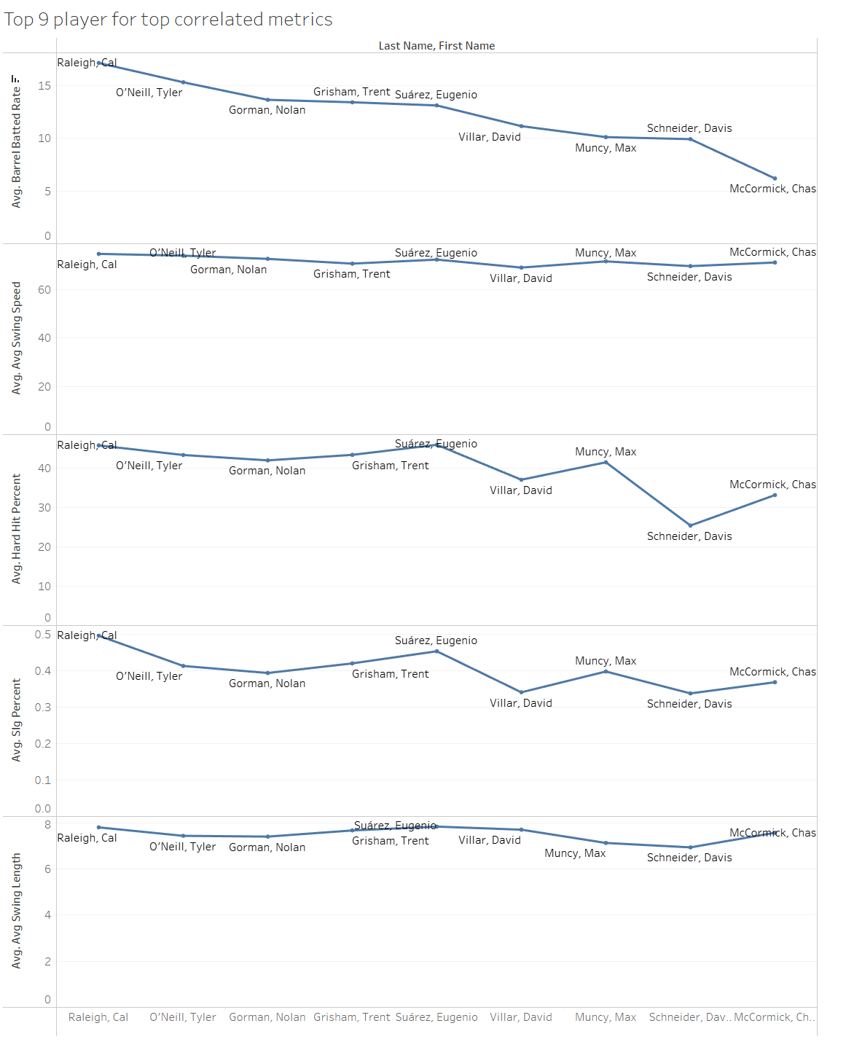
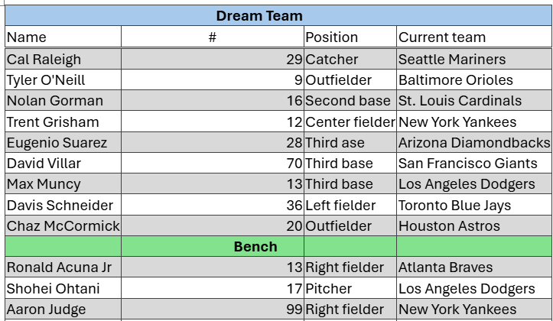
The Dream Team
Notes:
Last but not least the team roaster.

Slide 26
Conclusion
More Time is Needed
Baseball is Hard
Notes:
While the new swing path metrics are exciting more time (and data) is needed to separate the signal from the noise Overall while we were able to identify some trends and train our models to varying success ultimately the question of what makes a hitter good is a very complex one and there is a reason why every MLB team has million dollar analytics departments. It is not one that is going to be solved in one project, but rather a worthy target for continued study

